Slide 1
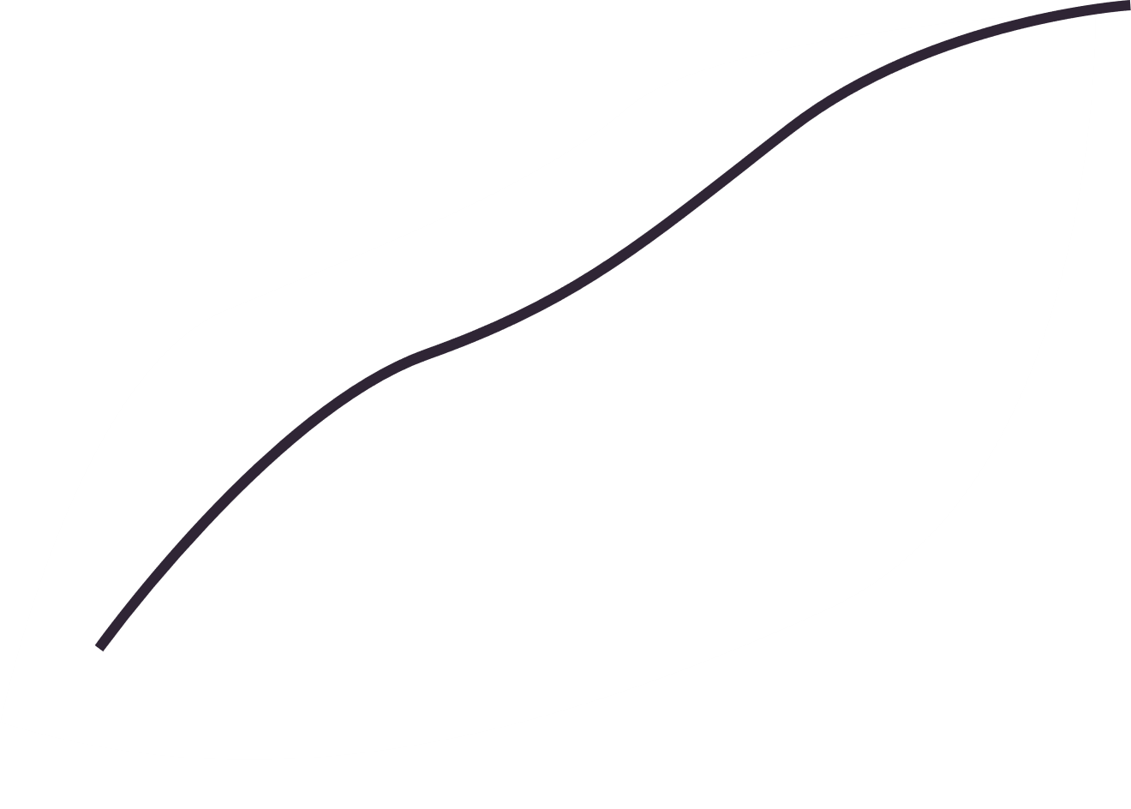

COVID-19 ANALYSIS IN MEXICO

Slide 2
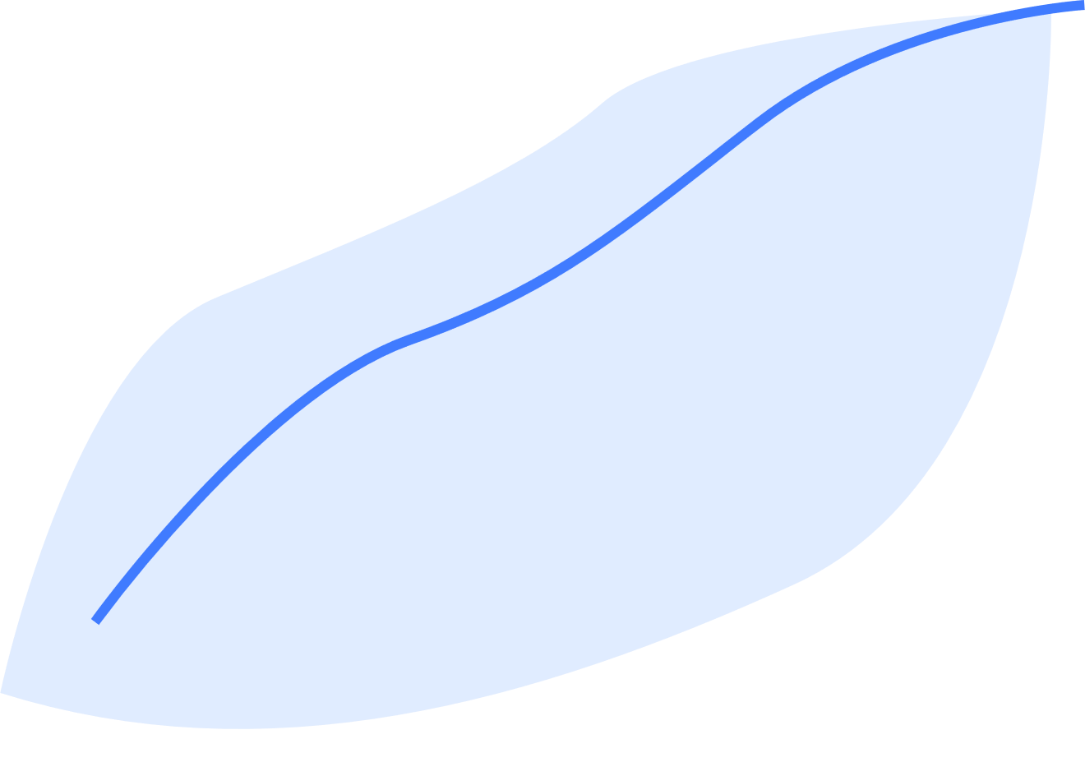

AGENDA
Introduction
Dataset
Exploratory Data Analysis
1st Statistical Test
2nd Statistical Test
Conclusion

Slide 3
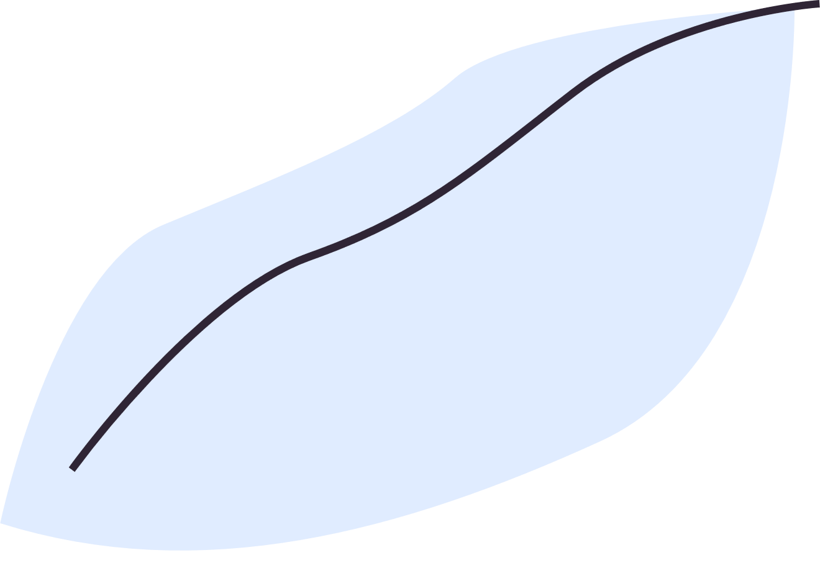

INTRODUCTION
Purpose: Conducting two statistical analyses to improve our capacity to predict the consequences of pandemics like COVID-19.
Goal: Reach conclusions that help us understand the complex effects of pandemics on different aspects of human existence.
Focus: Investigating critical characteristics such as age, habits, and comorbidities that determine the evolution and outcome of pandemics.

Slide 4
DATASET
Dataset provided by the Mexican government.
Accessible on Kaggle and has been licensed as a CC0 Public Domain License, allowing users unrestricted utilization.
1,048,576 unique rows and 21 features encompassing anonymized patient-related information, including pre-existing conditions.

Slide 5
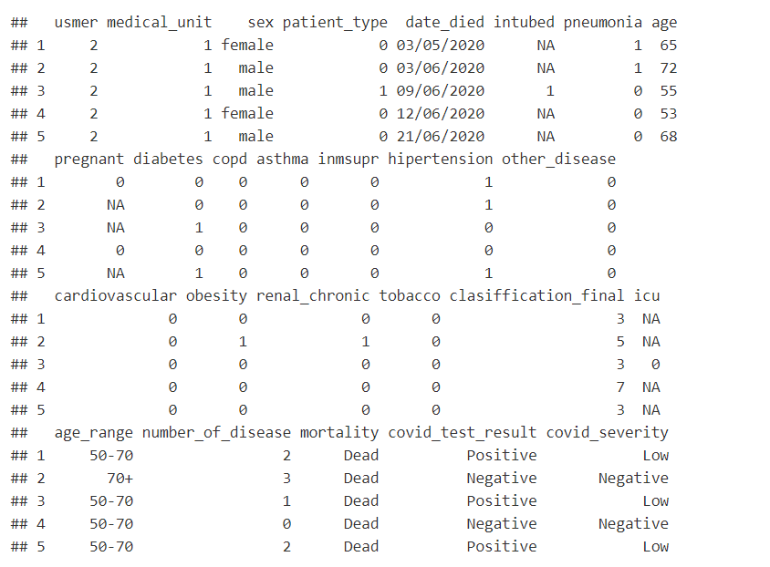
DATA CLEANING
Replaced null values with "NA".
Standardized data representation using 1s and 0s.
New features were added to categorize comorbidities, mortality, and COVID-19 test results for deeper insights

Slide 6



DATA ANALYSIS
Initial EDA

Slide 7
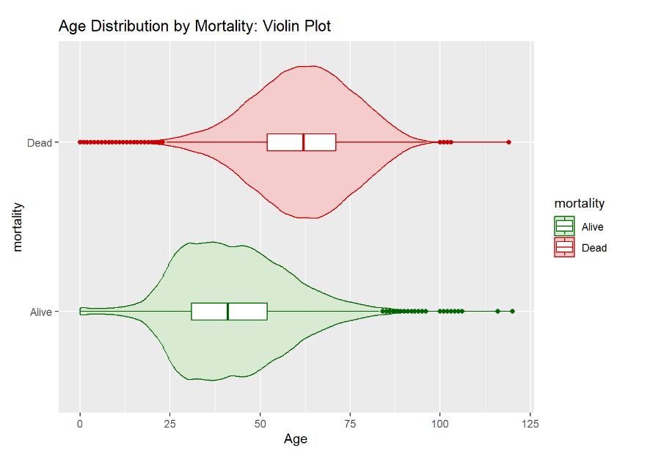

Slide 8
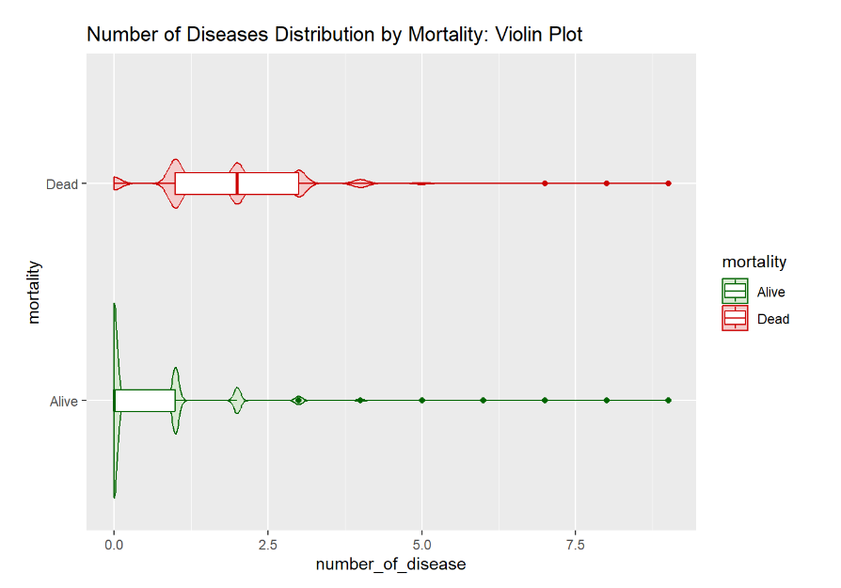

Slide 9
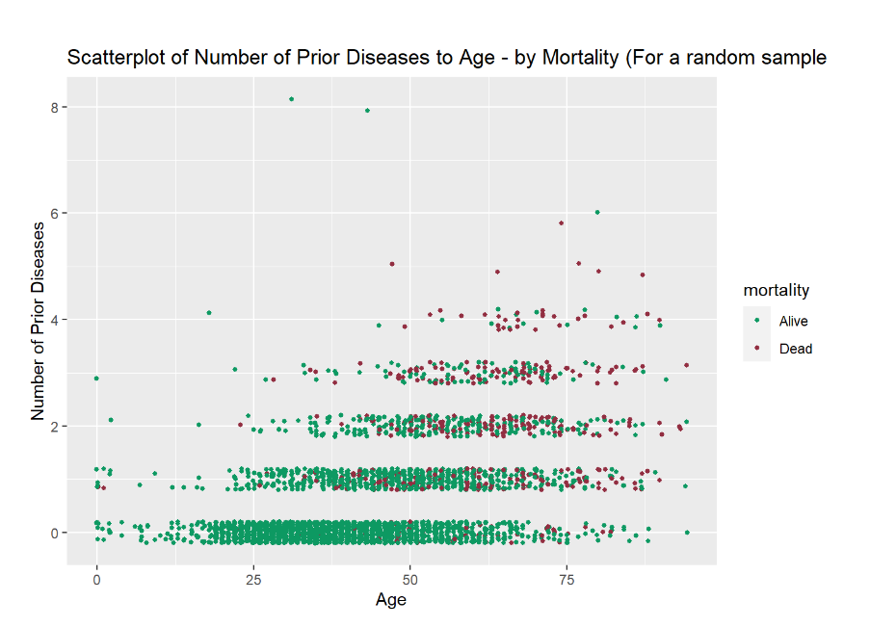

Slide 10
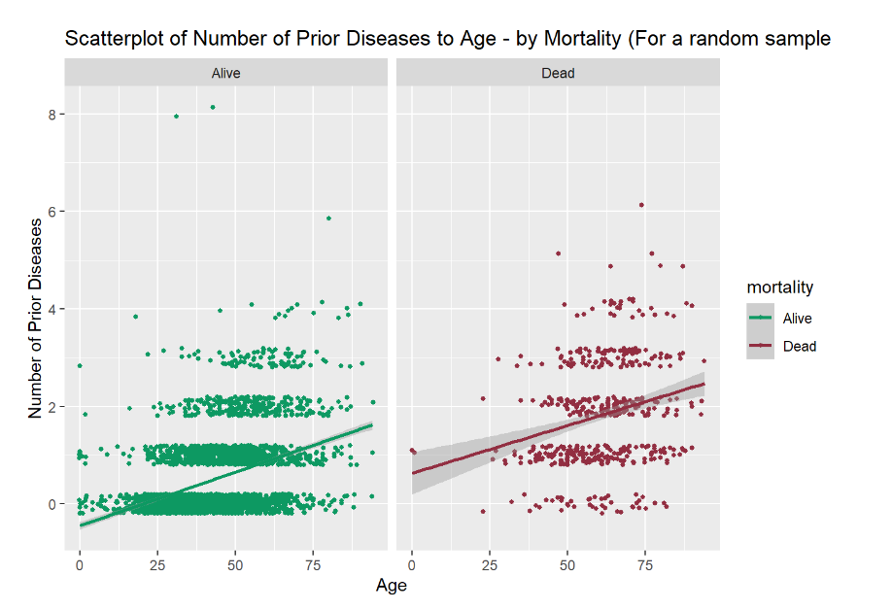

Slide 11


1ST STATISTICAL TEST
Hypothesis Testing

Slide 12
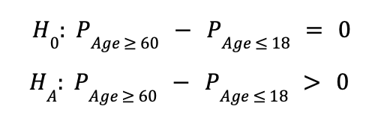
HYPOTHESIS:

Slide 13
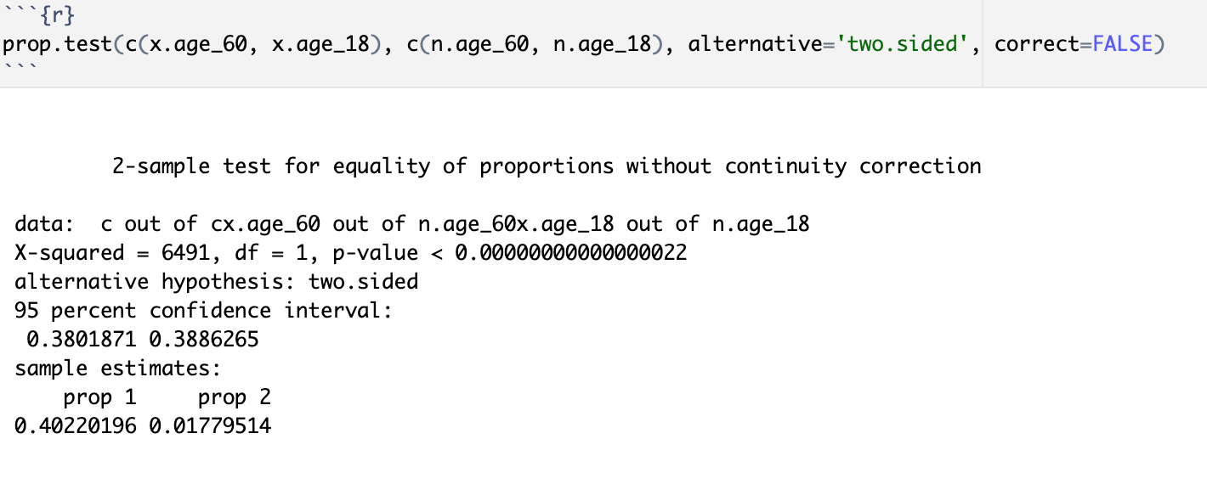
PROP.TEST
Observed difference in COVID mortality rates of individuals 60 and over and individuals 18: 0.3844

Slide 14
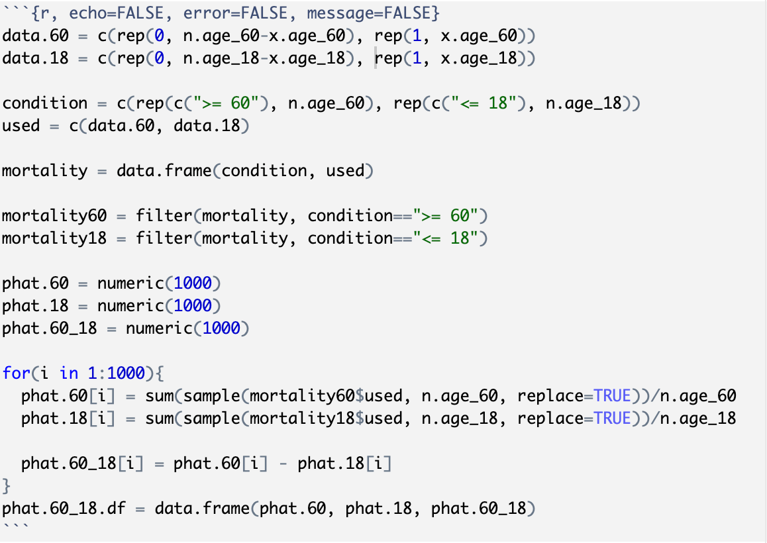
BOOTSTRAP (CODE)

Slide 15
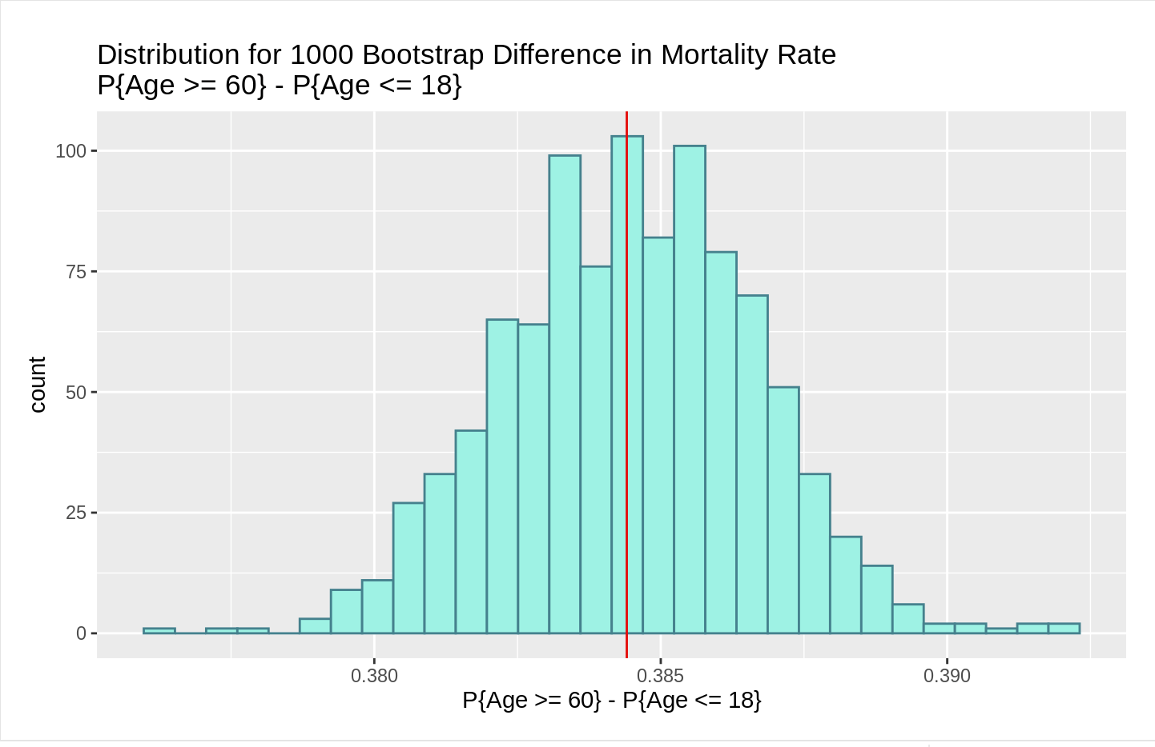
BOOTSTRAP

Slide 16
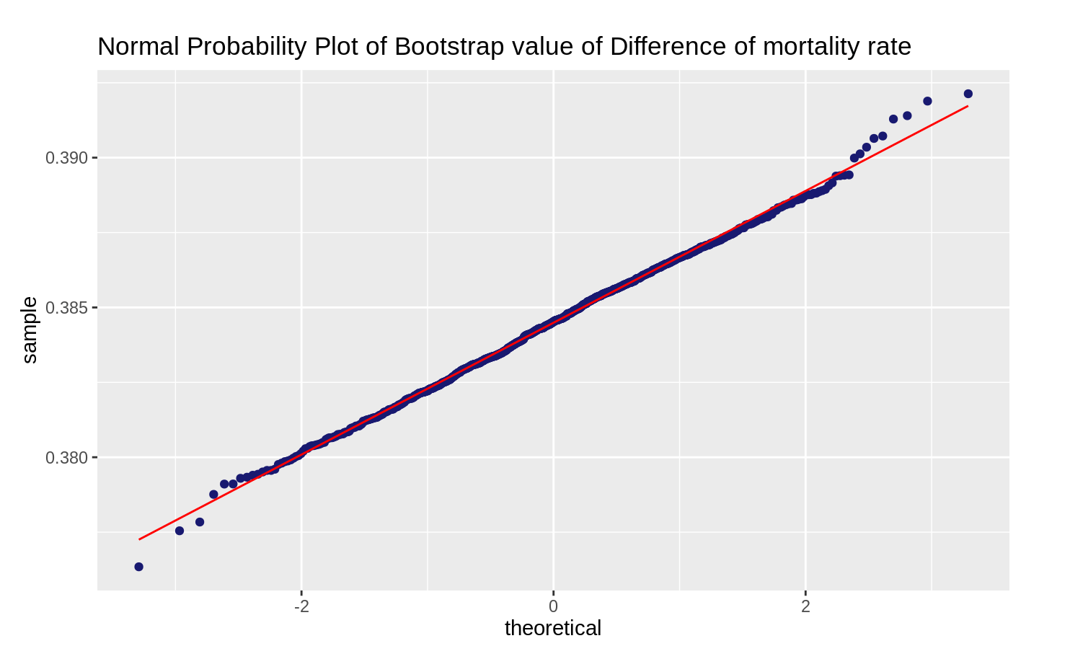
NORMALITY

Slide 17
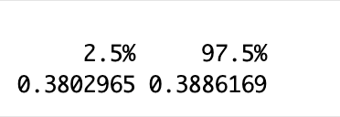
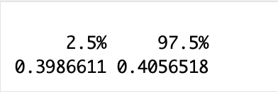
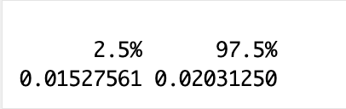
Bootstrap 95% Confidence Intervals:
Difference in proportions of age groups:
Observed: 0.3844
Proportion of 60 and Over Mortality Rate 95% CI:
Observed: 0.4022
Proportion of 18 and Under Mortality Rate 95% CI:
Observed: 0.0178

Slide 18
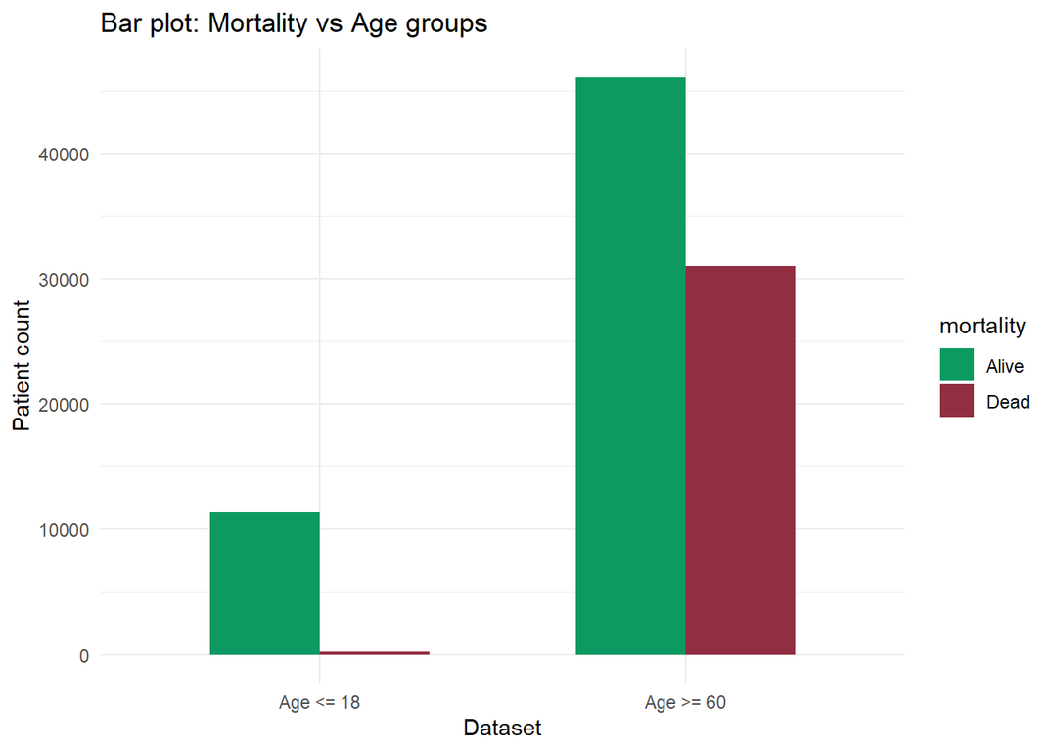
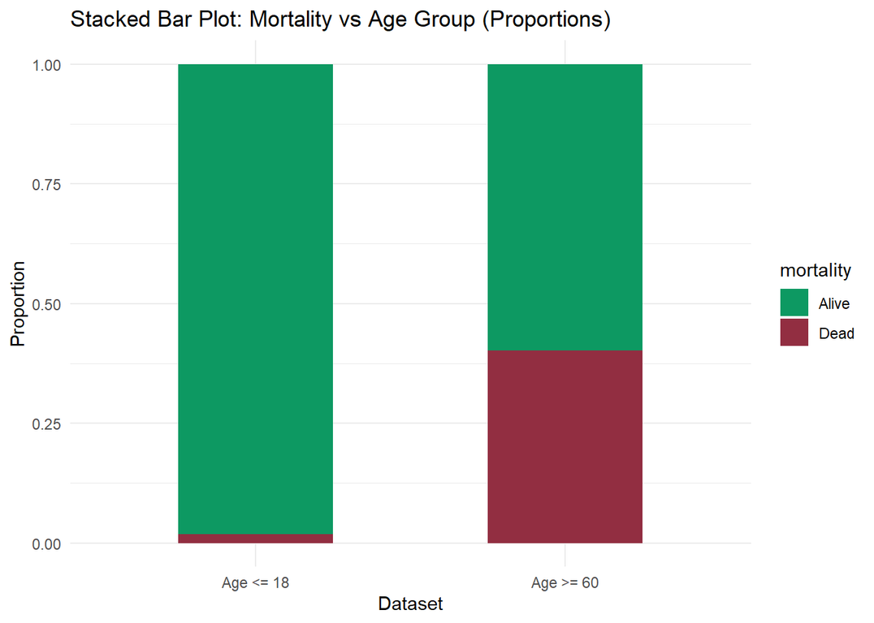
Visualization of Mortality Rate Based on Age Group
Using the whole population.

Slide 19

2ND STATISTICAL TEST
Chi-squared Test of Independence

Slide 20
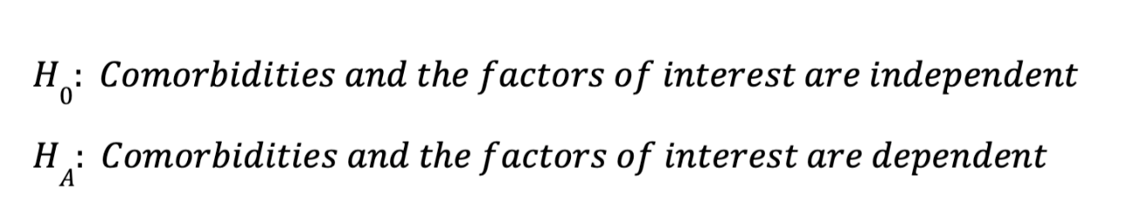
HYPOTHESIS:
Thanks to our large dataset, all Chi-Square tests will result in a rejection of null hypothesis (P-value = 2.2e-15)
This is the minimum P-value computable by R
However, let’s compute 500 data points instead...

Slide 21
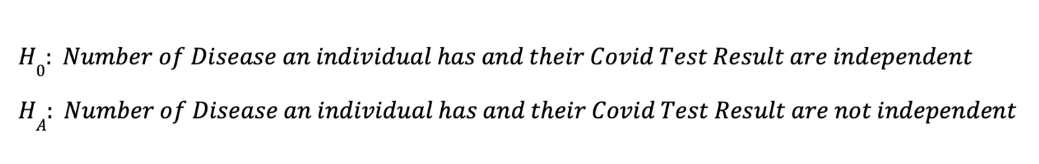
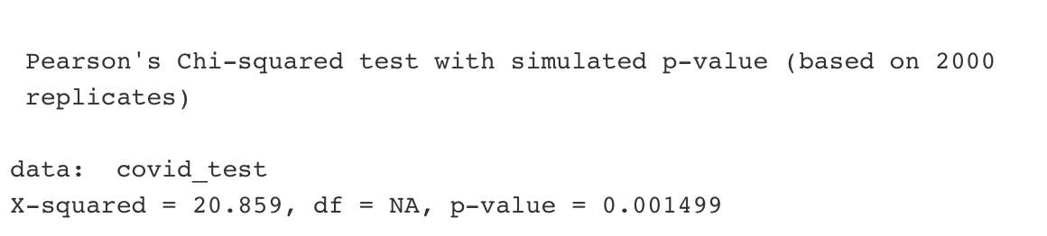
CHI-SQUARE TEST #1
Conclusion: Reject Null Hypothesis

Slide 22
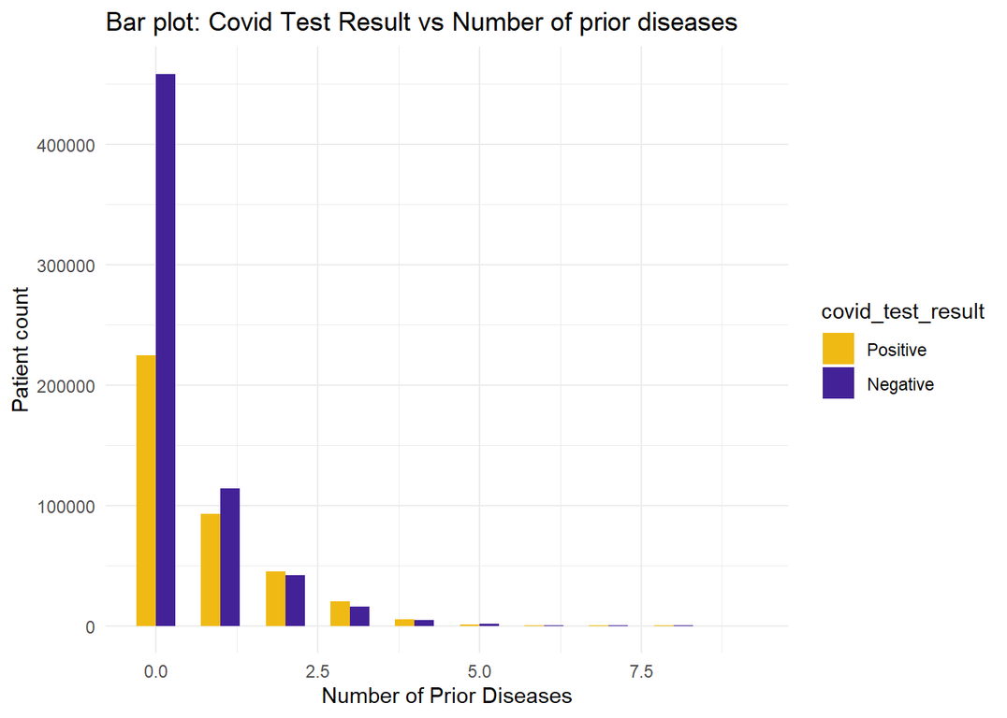
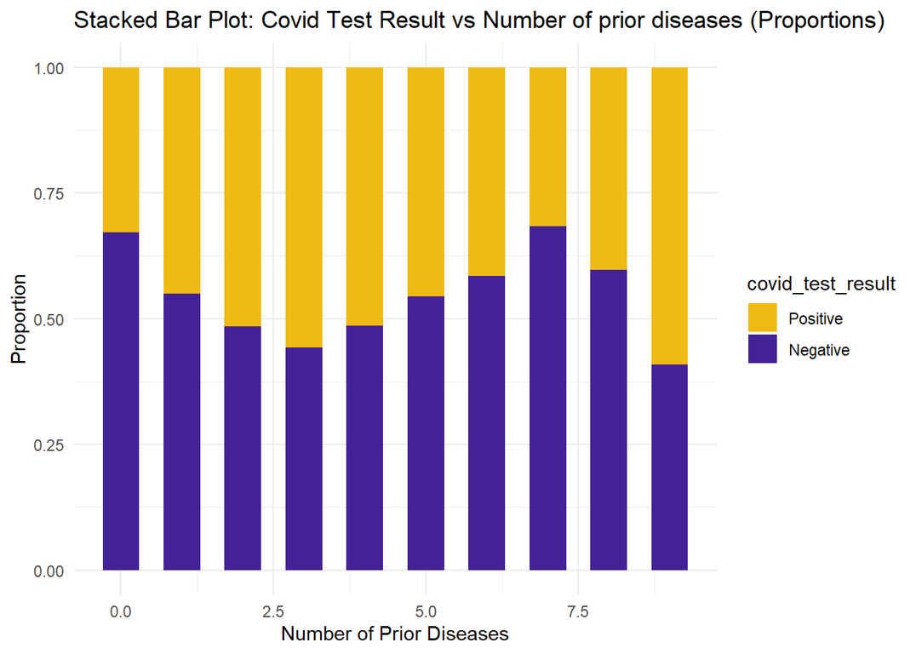
Visualization of Positive & Negative COVID Patient Count by Number of Diseases
Using the whole population.

Slide 23
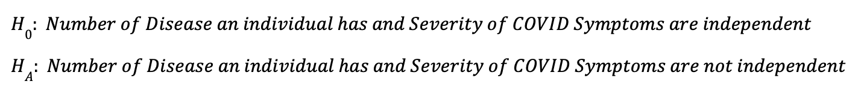
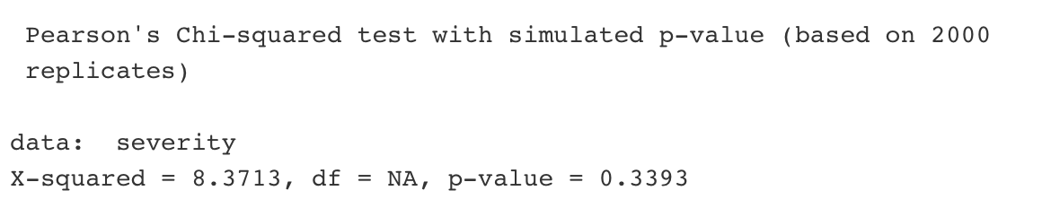
CHI-SQUARE TEST #2
Conclusion: Fail to Reject Null Hypothesis

Slide 24
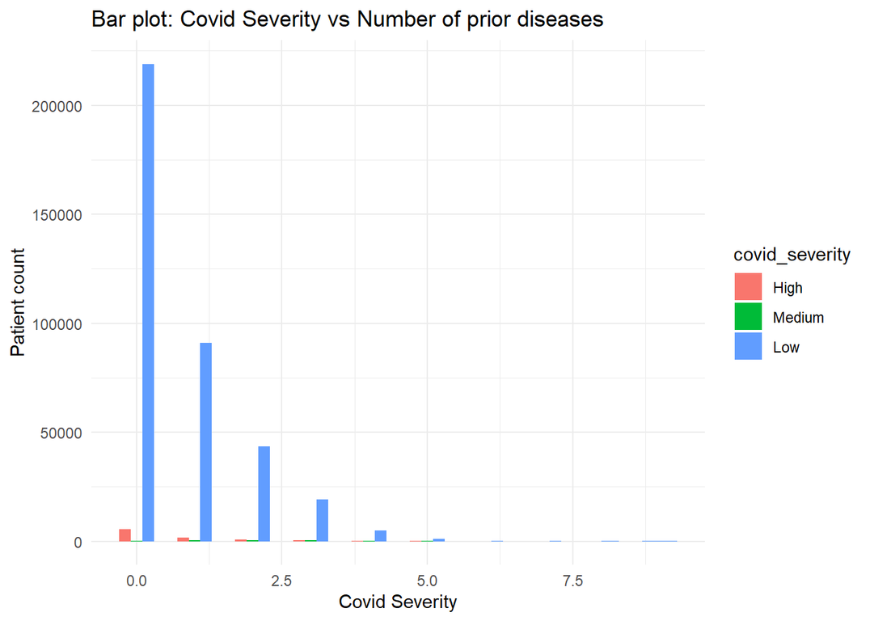
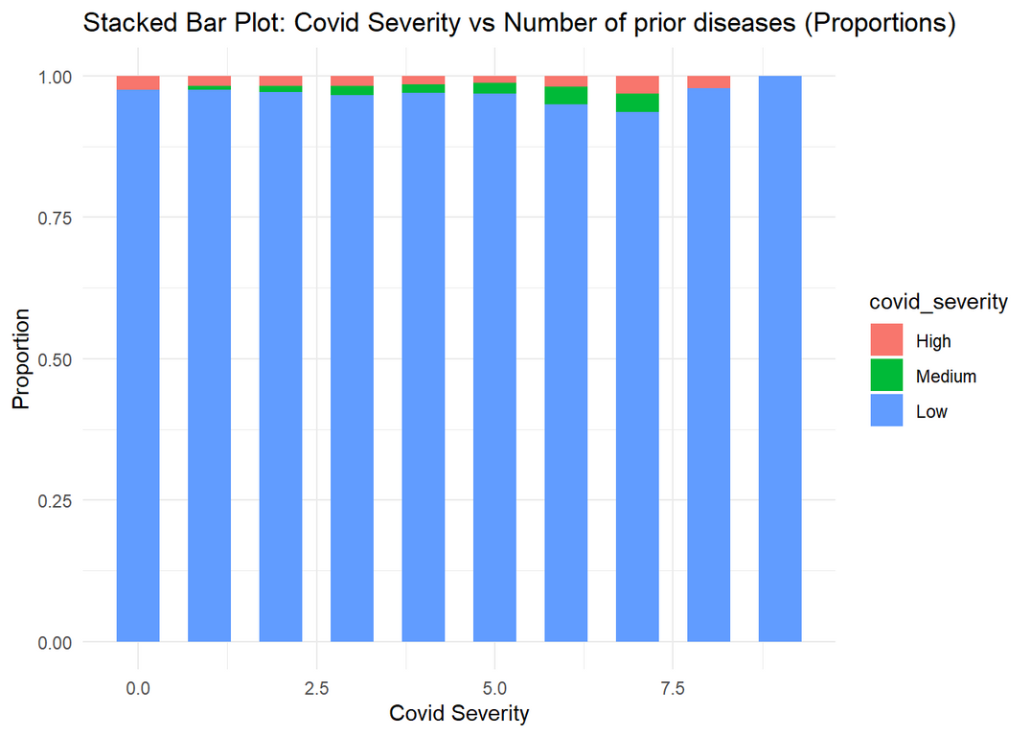
Visualization of Patient Count for each Level of COVID Severity
Using the whole population.

Slide 25
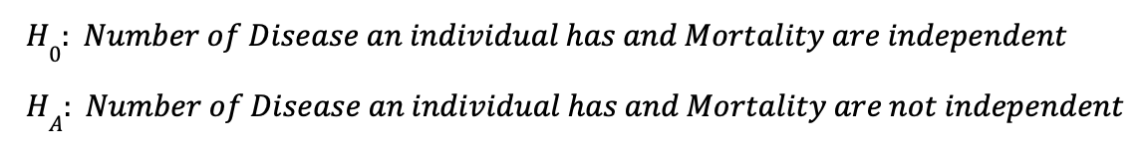
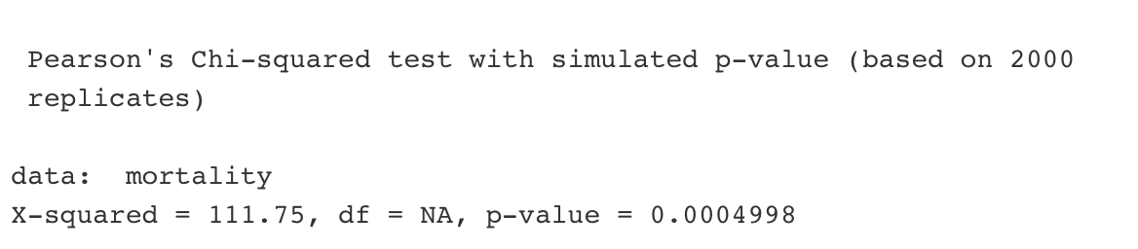
CHI-SQUARE TEST #3
Conclusion: Reject Null Hypothesis

Slide 26
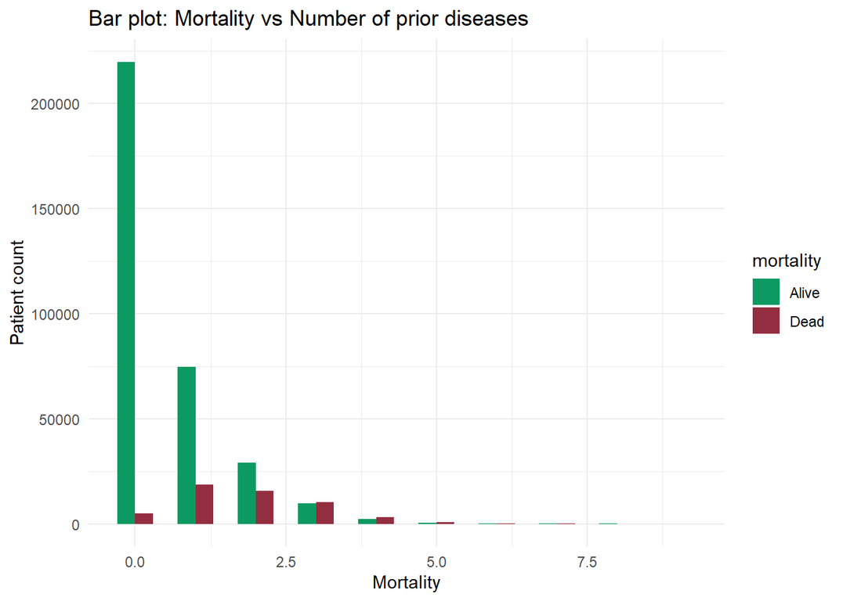
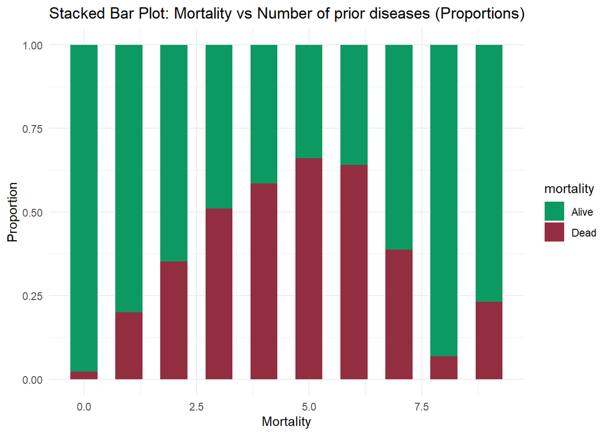
Visualization of Mortality Count for each Number of Diseases
Using the whole population.

Slide 27
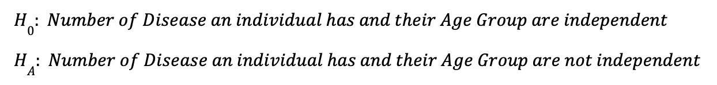
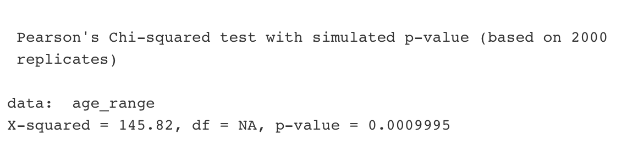
CHI-SQUARE TEST #4
Conclusion: Reject Null Hypothesis

Slide 28
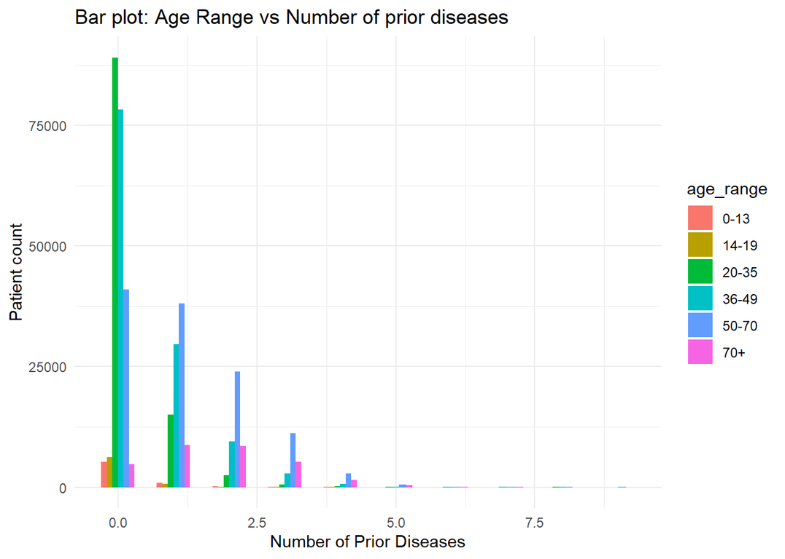
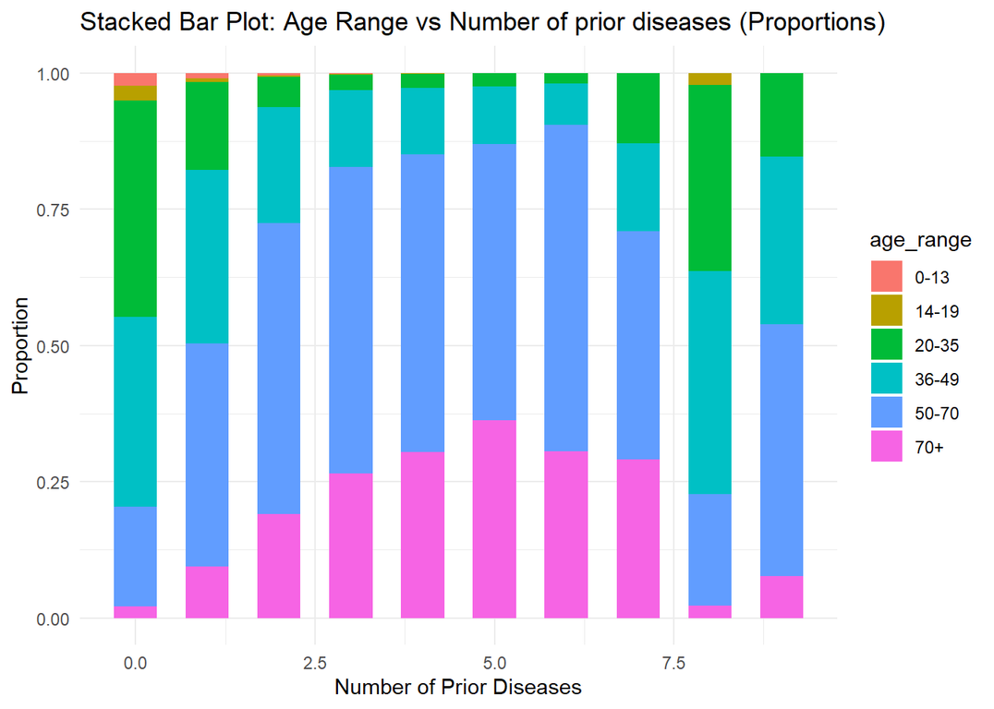
Visualization of Patient Count for each Age Group by Number of Diseases
Using the whole population.

Slide 29
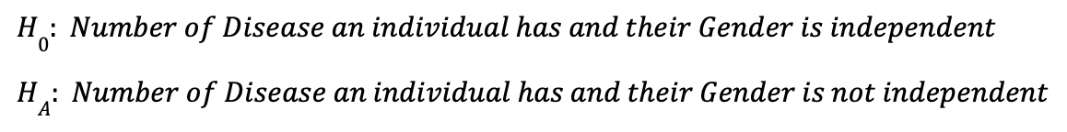
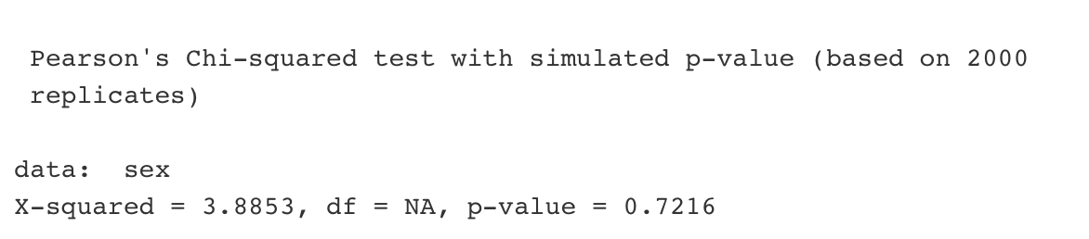
CHI-SQUARE TEST #5
Conclusion: Fail to Reject Null Hypothesis

Slide 30
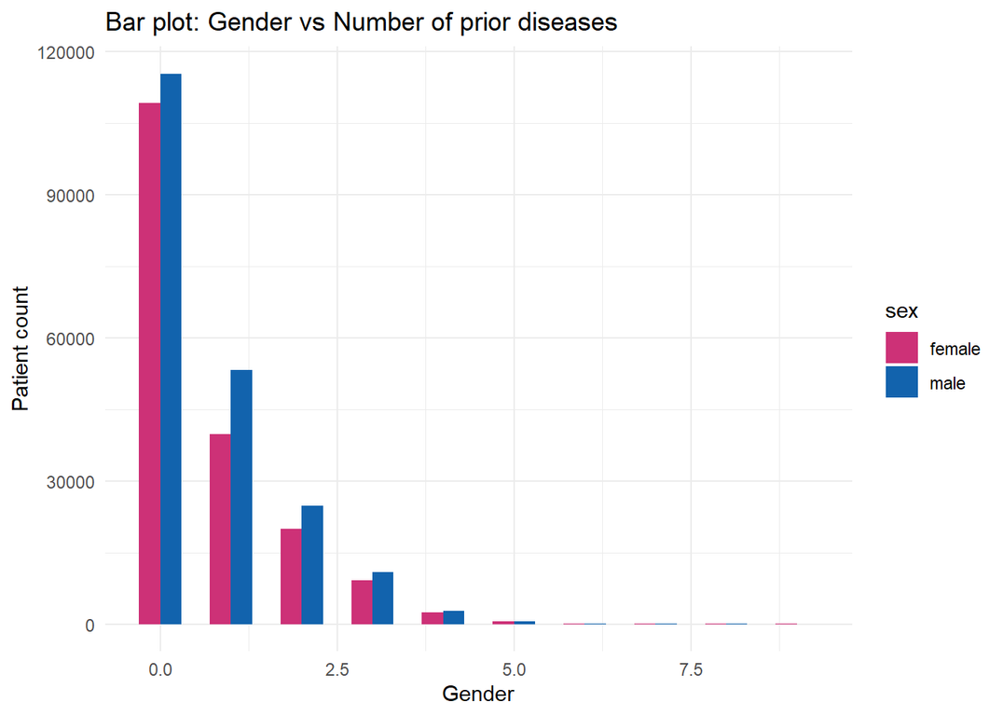
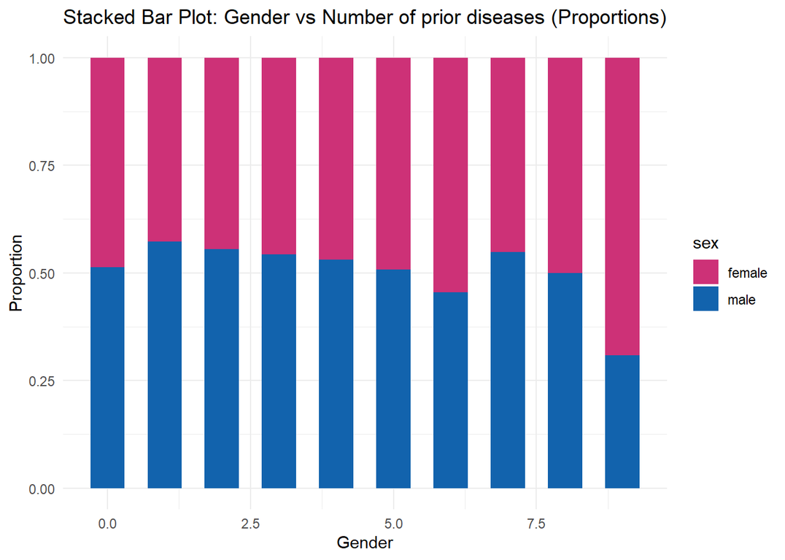
Visualization of Patient Count for each Gender by Number of Diseases
Using the whole population.

Slide 31
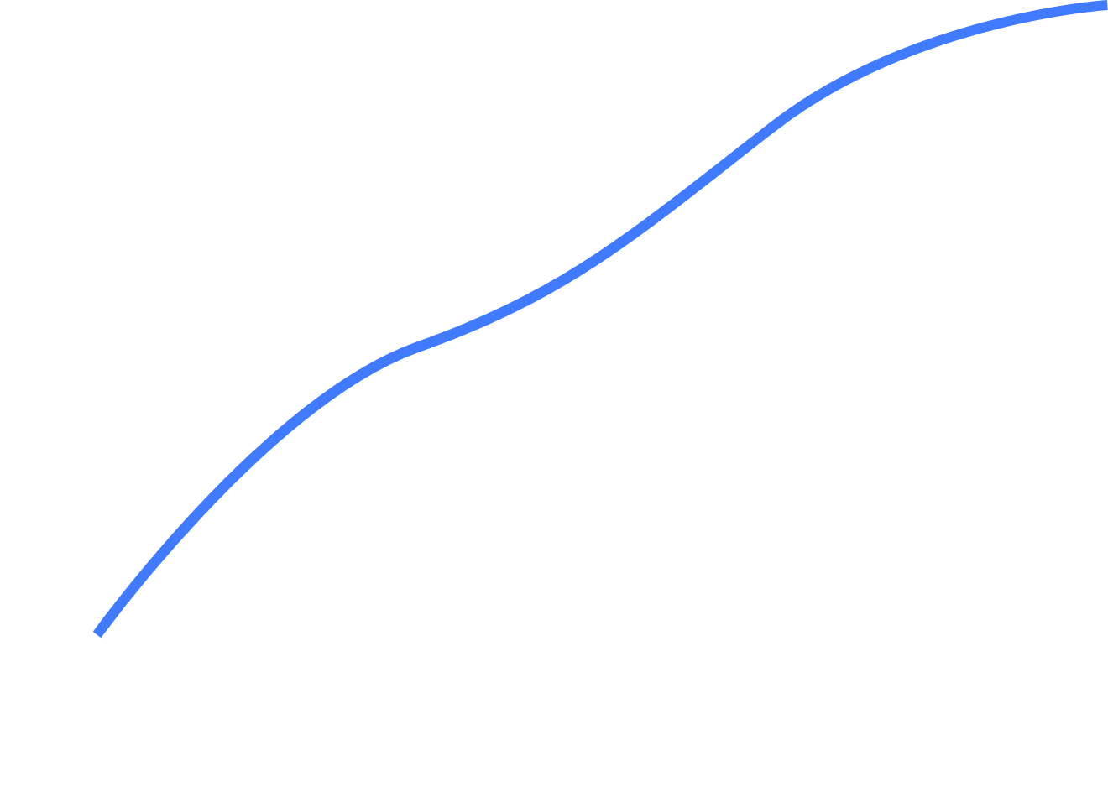

CONCLUSION
Results:
Hypothesis Testing
By rejecting the null hypothesis in our two-sample test for equality of proportions, it was established that individuals in the 60+ age group are significantly more vulnerable to COVID mortality compared to those 18 and under.
Prop.Test and Bootstrapping
Tight Confidence intervals replicable through both prop.test and bootstraps.
Chi-Square Tests
Results (500 data points):
Comorbidities and attributes, given our large dataset, will result in significant association.
To explore this data more, we sampled 500 data points from our dataset.
These results highlighted a significant association between the number of prior diseases an individual has and:
their likelihood of testing positive for COVID.
their mortality
their age group
but not the severity of their symptoms nor gender

